Slide 1
Text Similarity

Slide 2
By:
Elle Aliz binti Aminudin Gion Min Ming Thittima A/P Wat Zaiti Akta binti Zaharuddin

Slide 3
Text Similarity is one of NLP's basic methods used by its context or surface to find the closeness between two chunks of text.
INTRODUCTION

Slide 4
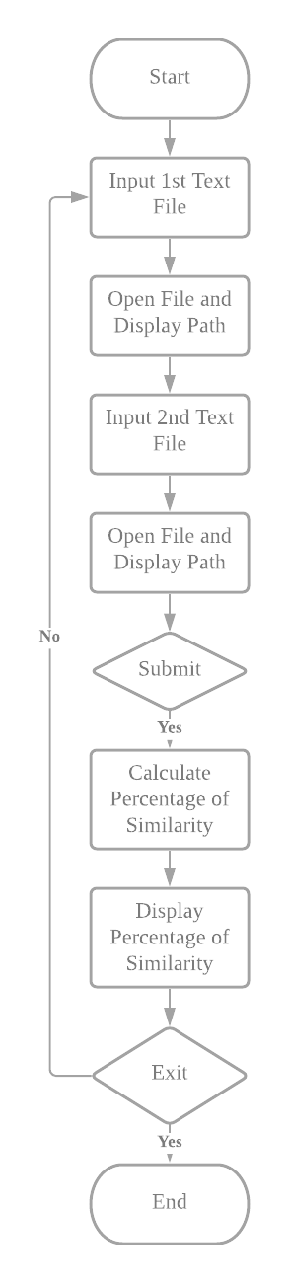
Flowchart

Slide 5
Pseudocode
Start
Input 1st Text File;
then File Open and Path Display;
Input 2nd Text File;
then File Open and Path Display;
If (Submit==yes);
Calculate Percentage of Similarity;
then Display Percentage of Similarity;
else
exit;
End

Slide 6
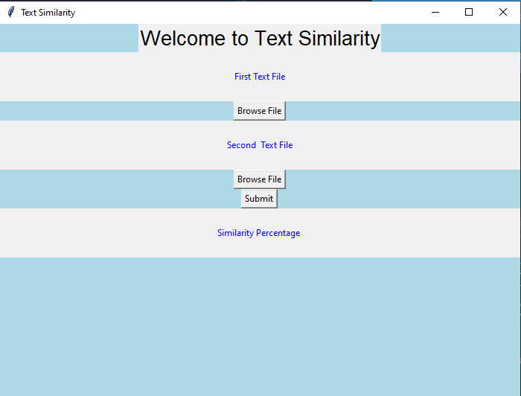
Interfaces
The interface was made by using Tkinter. Tkinter is a framework provides Python users with a simple way to create GUI elements using the widgets found in the Tk toolkit.

Slide 7
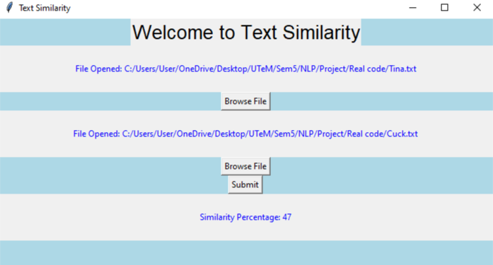
Path of the Browse File
The Similarities Percentage from Both Browse File

Slide 8
Strength and Weakness of System
Strength
Weakness
Can check the percentage of similarities of document in a fleeting period.
Friendly User Interfaces
Available and free for all users
Cannot compare with many text files in one time
Only allow text file
Cannot compare with doc in the google like Turnitin.

Slide 9
In conclusion, this Text Similarity can be used in real life but there are some weaknesses. Based on our opinion, this system’s development is straightforward and does not require a lengthy time to execute. Our system can contribute to the education sector especially for lecturers and students alike. Students can check the similarity of their work directly with the references that are involved before turning in their assignments.
Conclusion

